Slide 1
Lab2 Problems

Slide 2
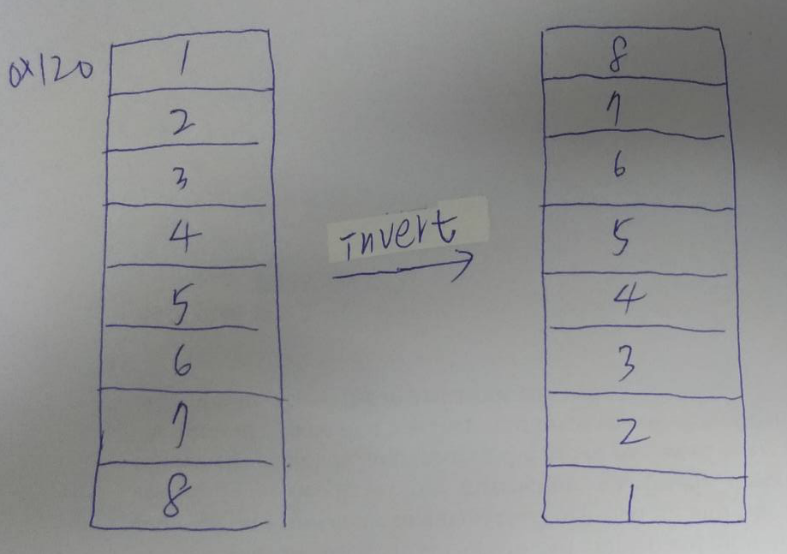
Lab2 for class A
Please build one arrays which can push 8 values. The value of one array is “1” to “8.
Inverts the value of the array. The mean is “1~8” become “8~1”.

